Slide 1
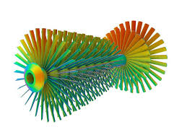
Finite Element Analysis of a Hexagon Structure
This project explores the structural behavior of a regular hexagon using Static Structural and Transient Structural simulation techniques.
Zarrar Ahmed Qureshi
ME-1867 Section: A

Slide 2
Abstract: Unveiling Structural Dynamics
Material Properties
Loading Conditions
Boundary Conditions
Young's Modulus: 67,000 MPa (from roll number ME-1867).
Poisson's Ratio: 0.28.
Static Load: 2,011 N (from date of birth). Transient Load: 281.5 N (from USD to PKR exchange rate).
One face fixed, remote force applied at one-third of the face length.
The analysis compares deformation and stress results between static equilibrium and time-dependent transient responses.

Slide 3

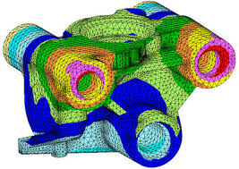
Introduction to FEA
Finite Element Analysis (FEA) is a numerical method predicting part behavior under physical conditions. This project analyzes a regular hexagon under two conditions:
Static Structural
Assumes slow load application, ignoring inertial and damping effects.
Transient Structural
Analyzes dynamic response over time, considering inertia and damping.

Slide 4






Problem Statement: Custom Constraints
The objective is to analyze a regular hexagon structure under custom-defined constraints based on personal data.
Loading Conditions
Static Load: 2,011 N (from date of birth). Transient Load: 280.5 N (from USD to PKR exchange rate).
Material Properties
Boundary Conditions
Young's Modulus (E): 67 times 1,000 = 67,000 MPa.
Poisson's Ratio: v = 0.28.
One face fixed, remote force at 1/3rd distance. Time Step (Transient): 0.2 seconds.

Slide 5
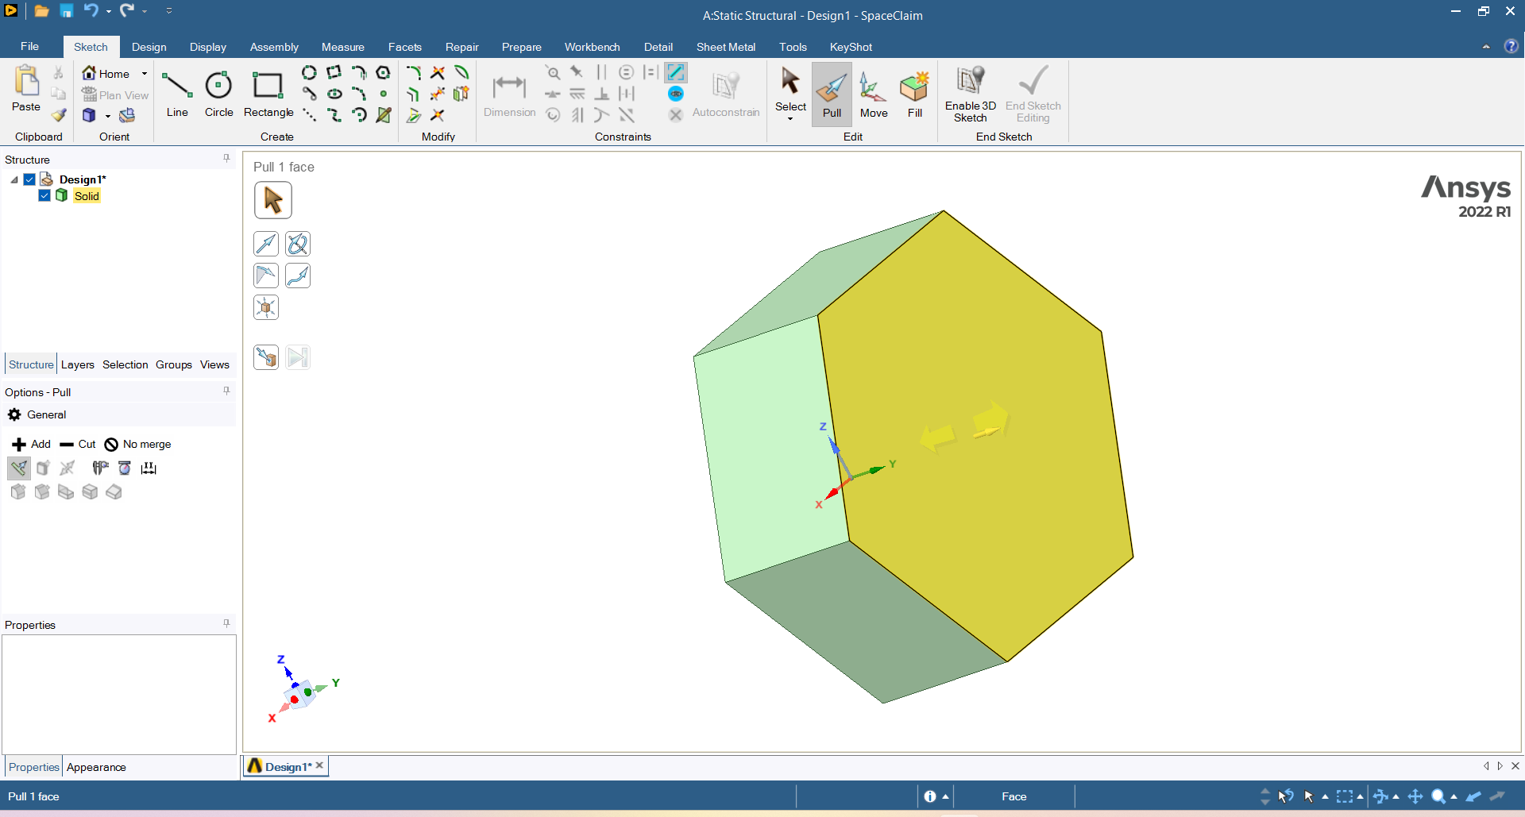
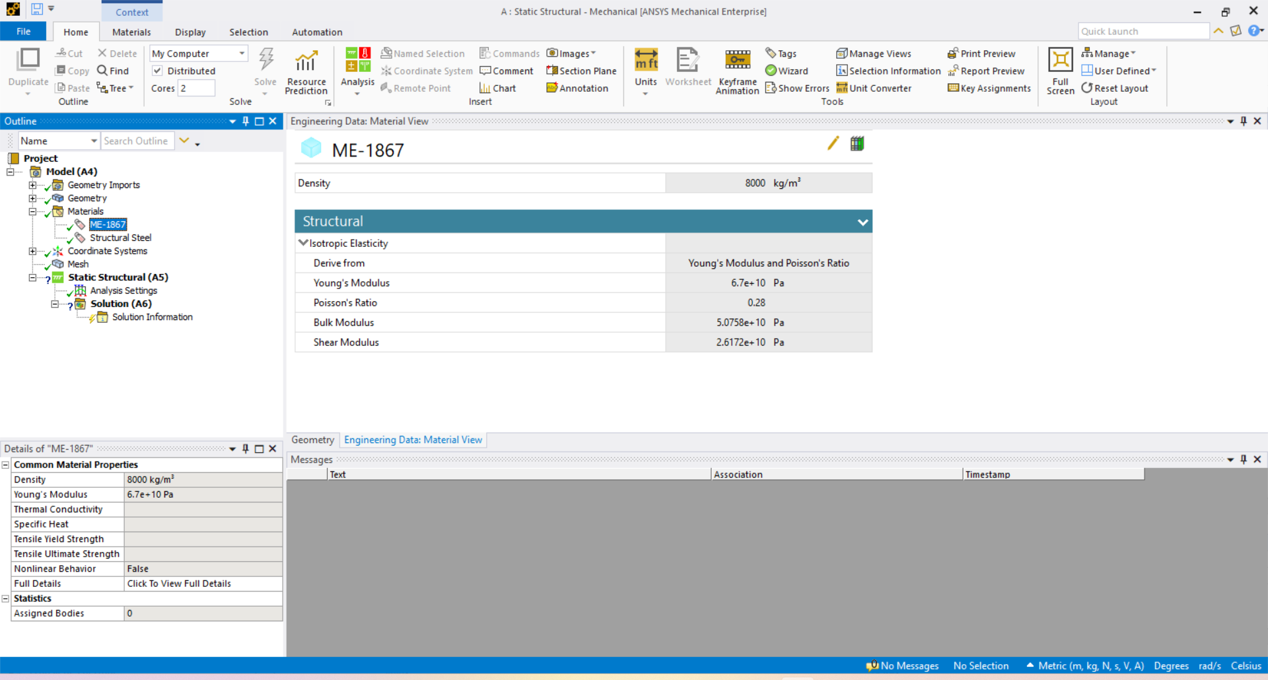
Geometry Modeling & Material Definition
Geometry Modeling
Material Properties
The regular hexagon was extruded to a specified thickness using DesignModeler/SpaceClaim within Ansys.
A custom material, “ME-1867" was defined with calculated stiffness values.
Figure 2: Engineering Data showing Young's Modulus of 67000 MPa.
Figure 1: 3D Geometry of the extruded hexagon model.

Slide 6
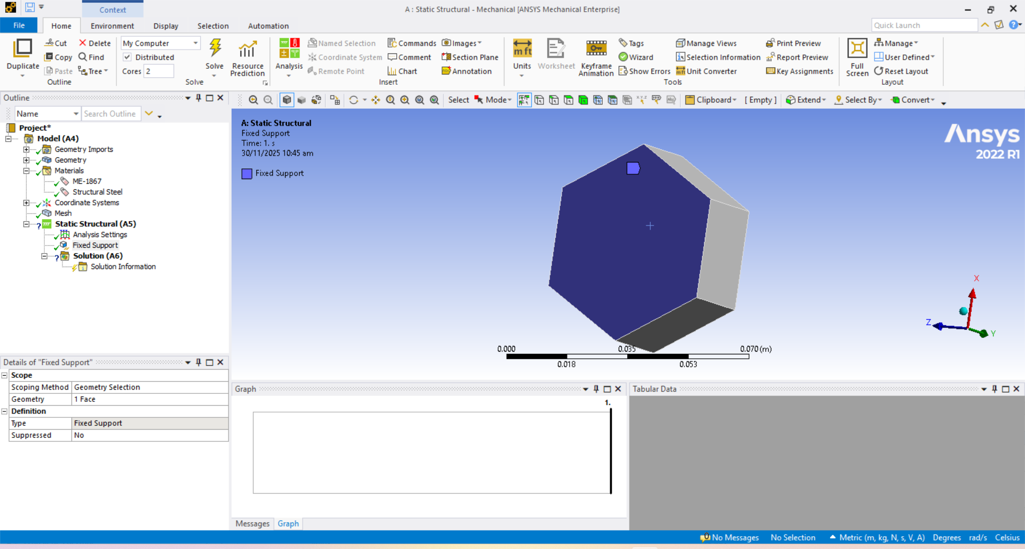
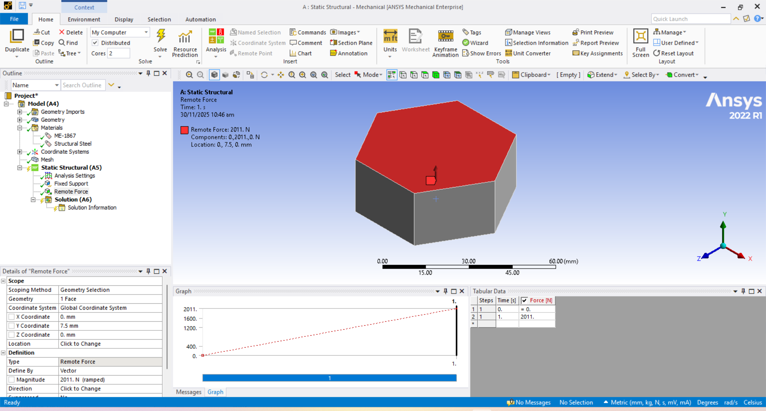
Boundary Conditions: Simulating Reality
To simulate physical bending and shear, specific constraints were applied.
Fixed Support
Applied to one side face of the hexagon.
Remote Force
Applied to the same face but offset to 1/3rd of the length, inducing rotation/bending.
Figure 3: Fixed Support applied to the face.
Figure 4: Remote Force applied at 1/3rd offset location.

Slide 7
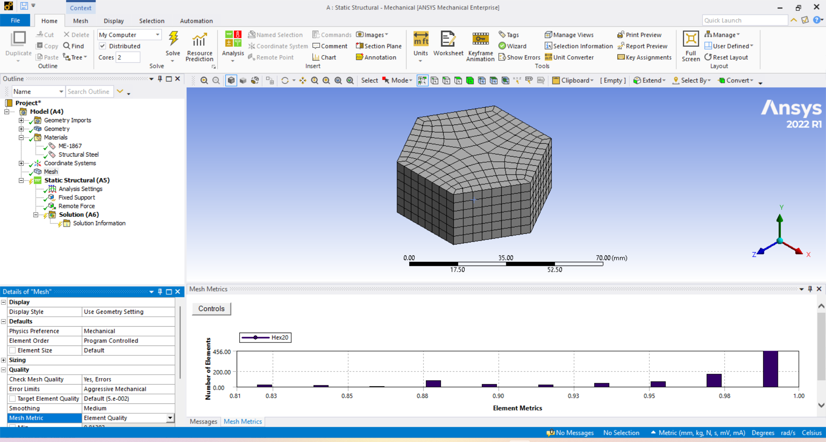
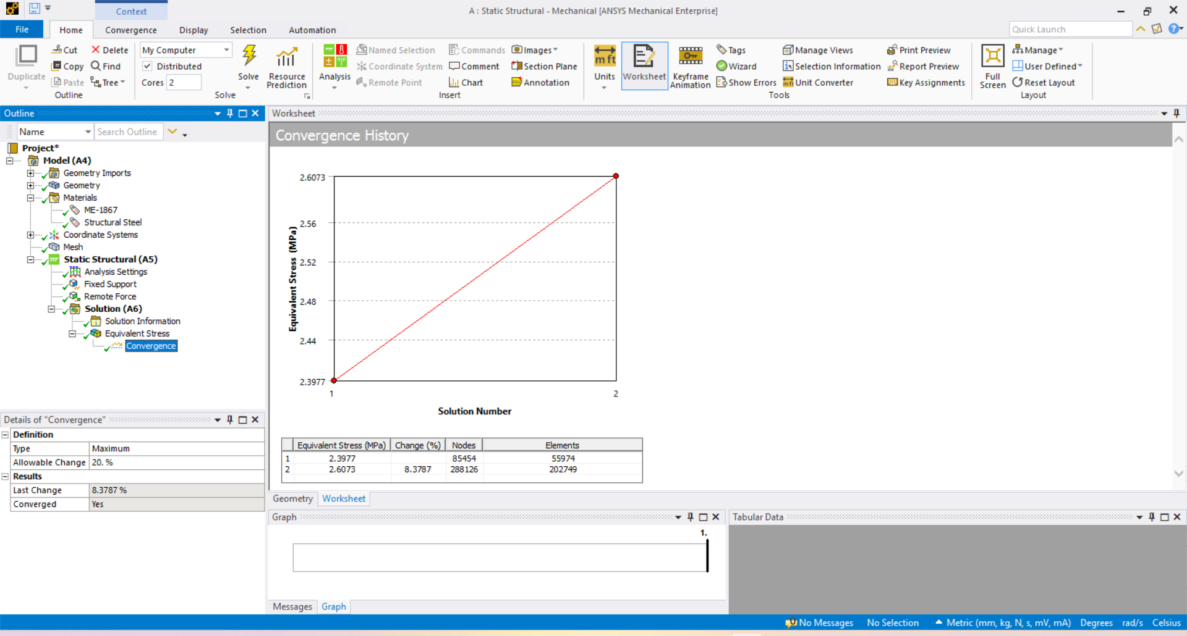
Meshing & Convergence for Accuracy
A mesh convergence study was conducted to ensure result accuracy, refining the mesh in three iterations to observe Equivalent Stress stability.
Figure 5: Meshed model of the hexagon with element Quality.
Figure 6: Mesh Convergence Graph (Nodes vs. Stress).

Slide 8
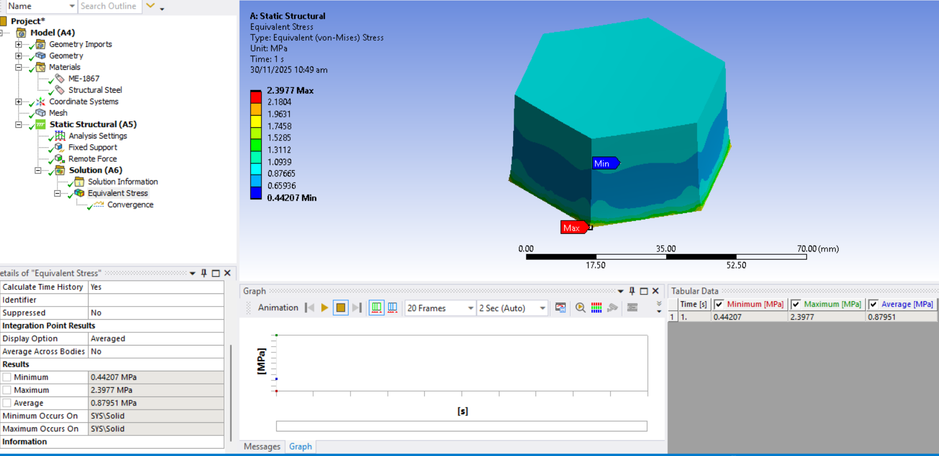
Static Structural Simulation: Equilibrium Analysis
In the static analysis, a load of 2,020 N was applied, and the solver calculated the final equilibrium state.
Equivalent (von-Mises) Stress (Static)
Results: The static results show maximum stress at the hexagon's tips of the fixed face.

Slide 9
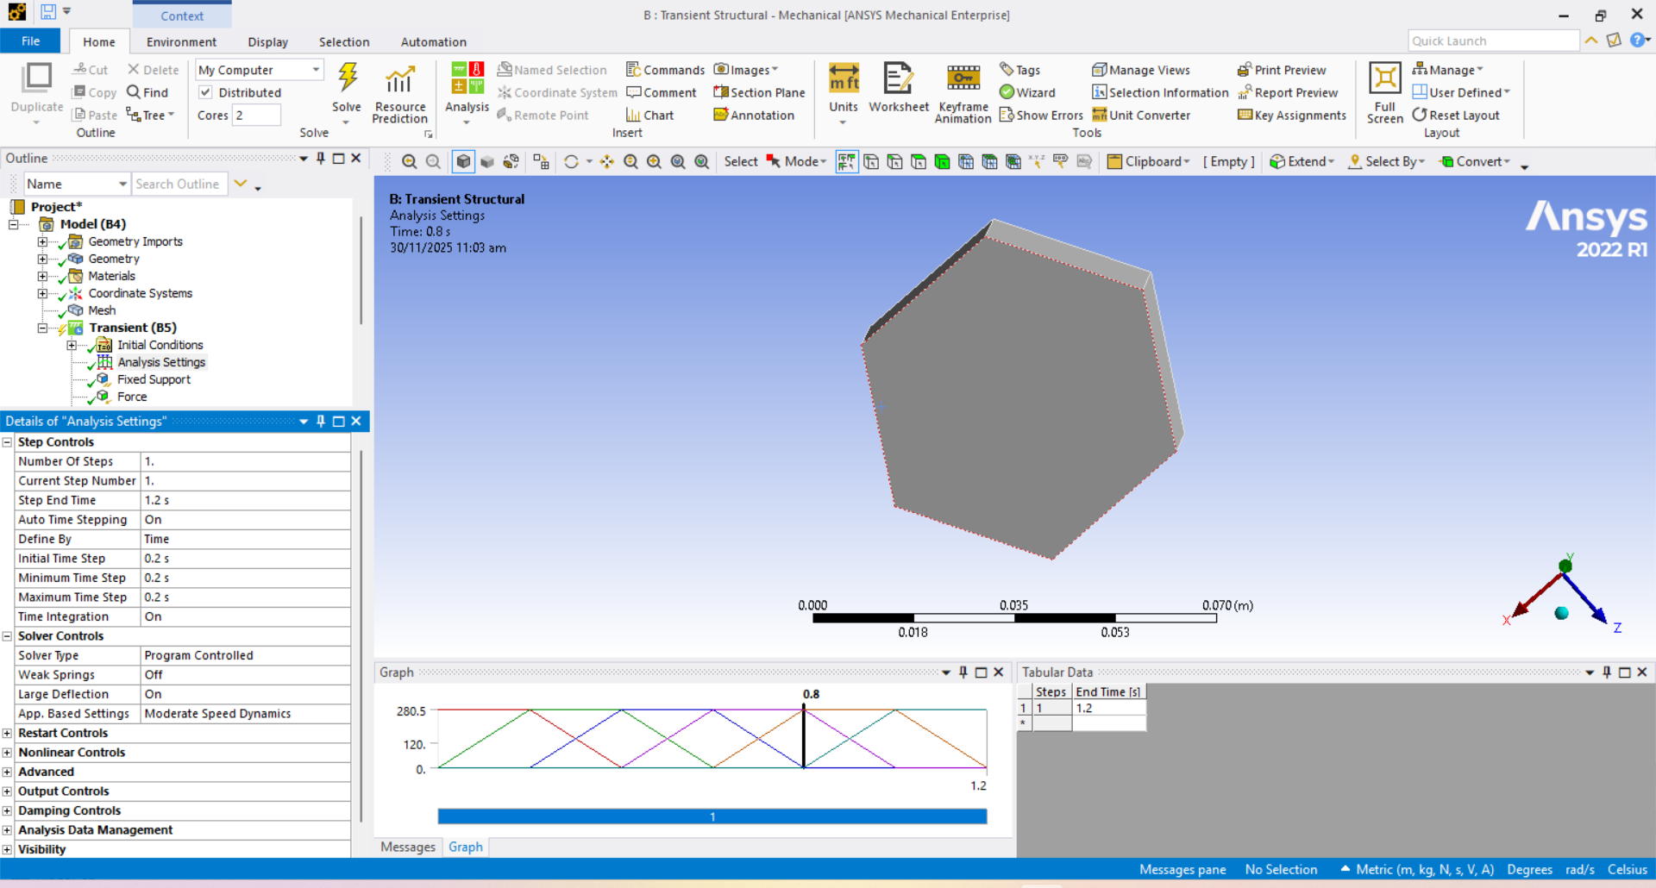
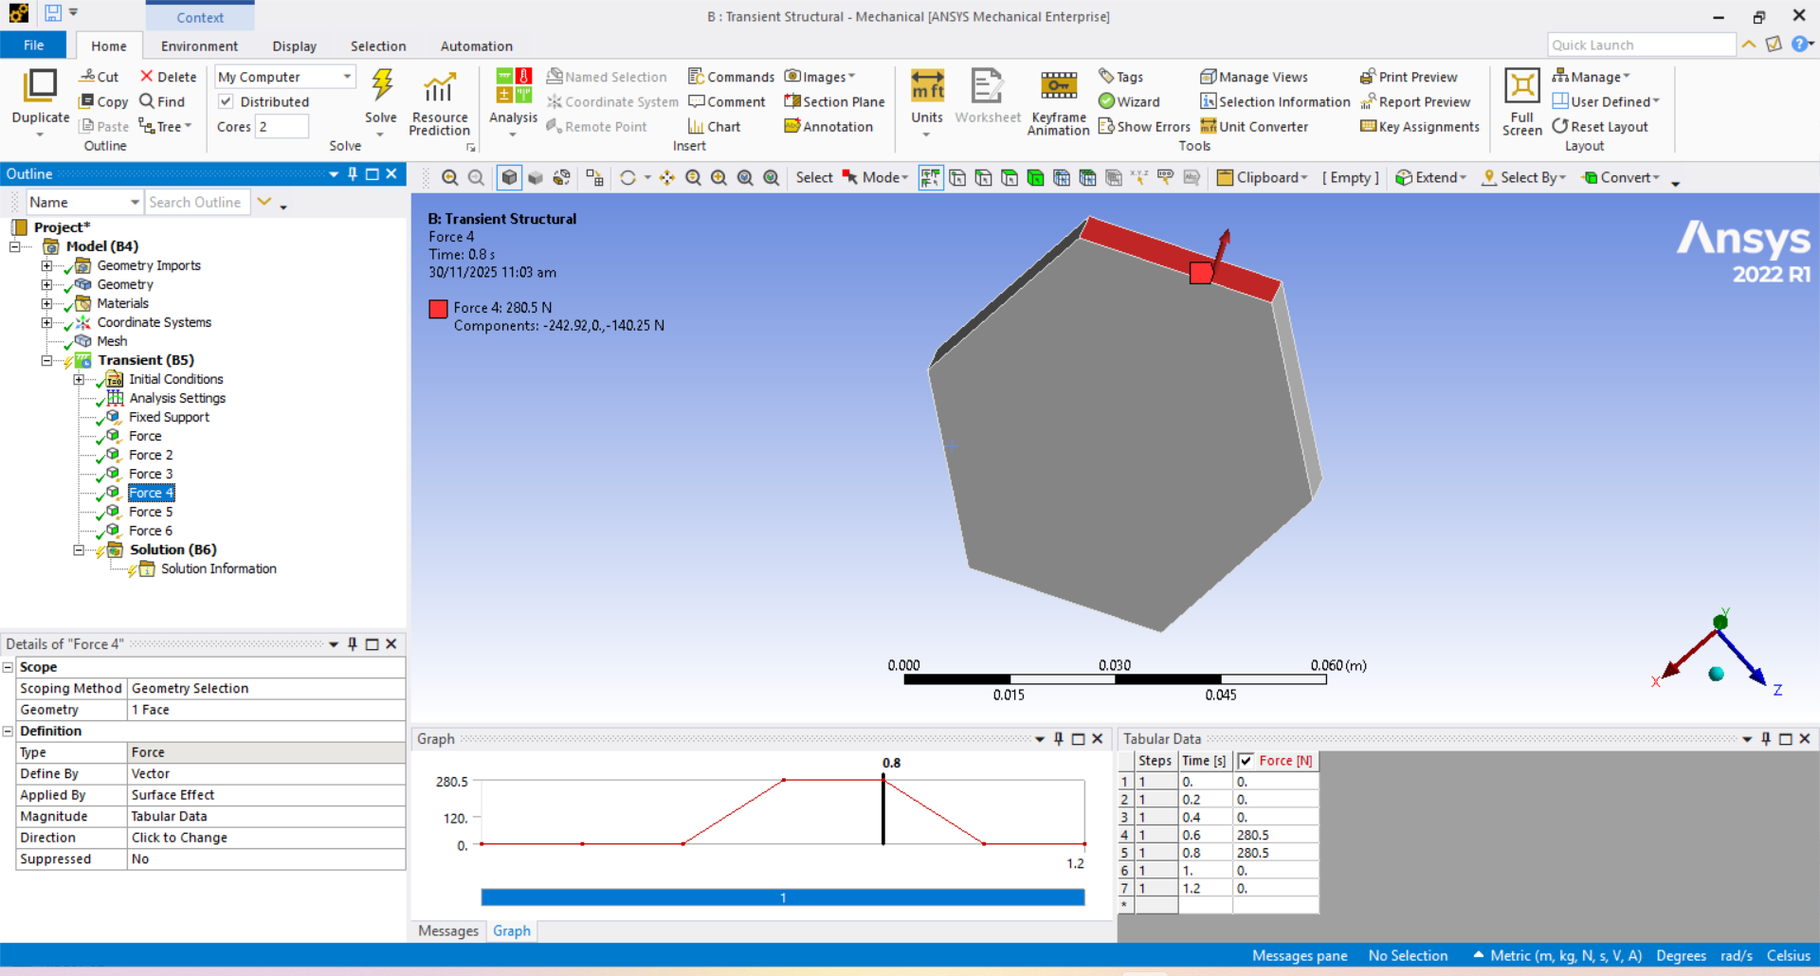

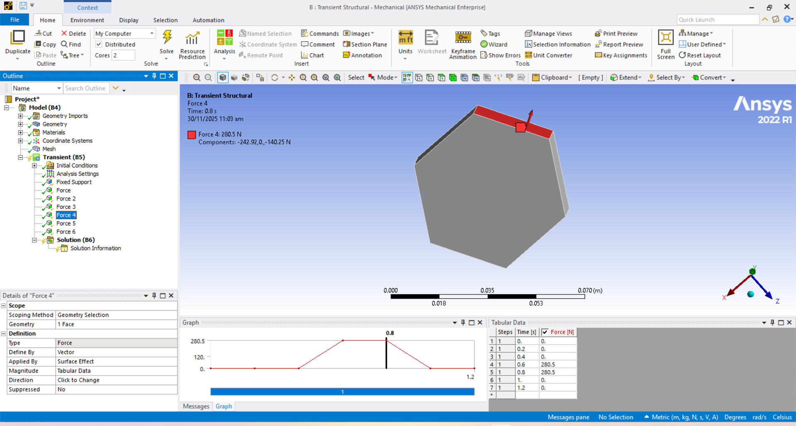
Transient Structural Simulation: Dynamic Response
The Transient Structural analysis determined the time-dependent response under a standard dynamic load over 1 second.
1
2
Load
Step End Time
280.5 N (USD Rate).
1.2 s.
3
Time Step
0.2 s.
Figure 9: Transient setup showing time steps of 0.2s and tabular data of force 3 with graph.

Slide 10
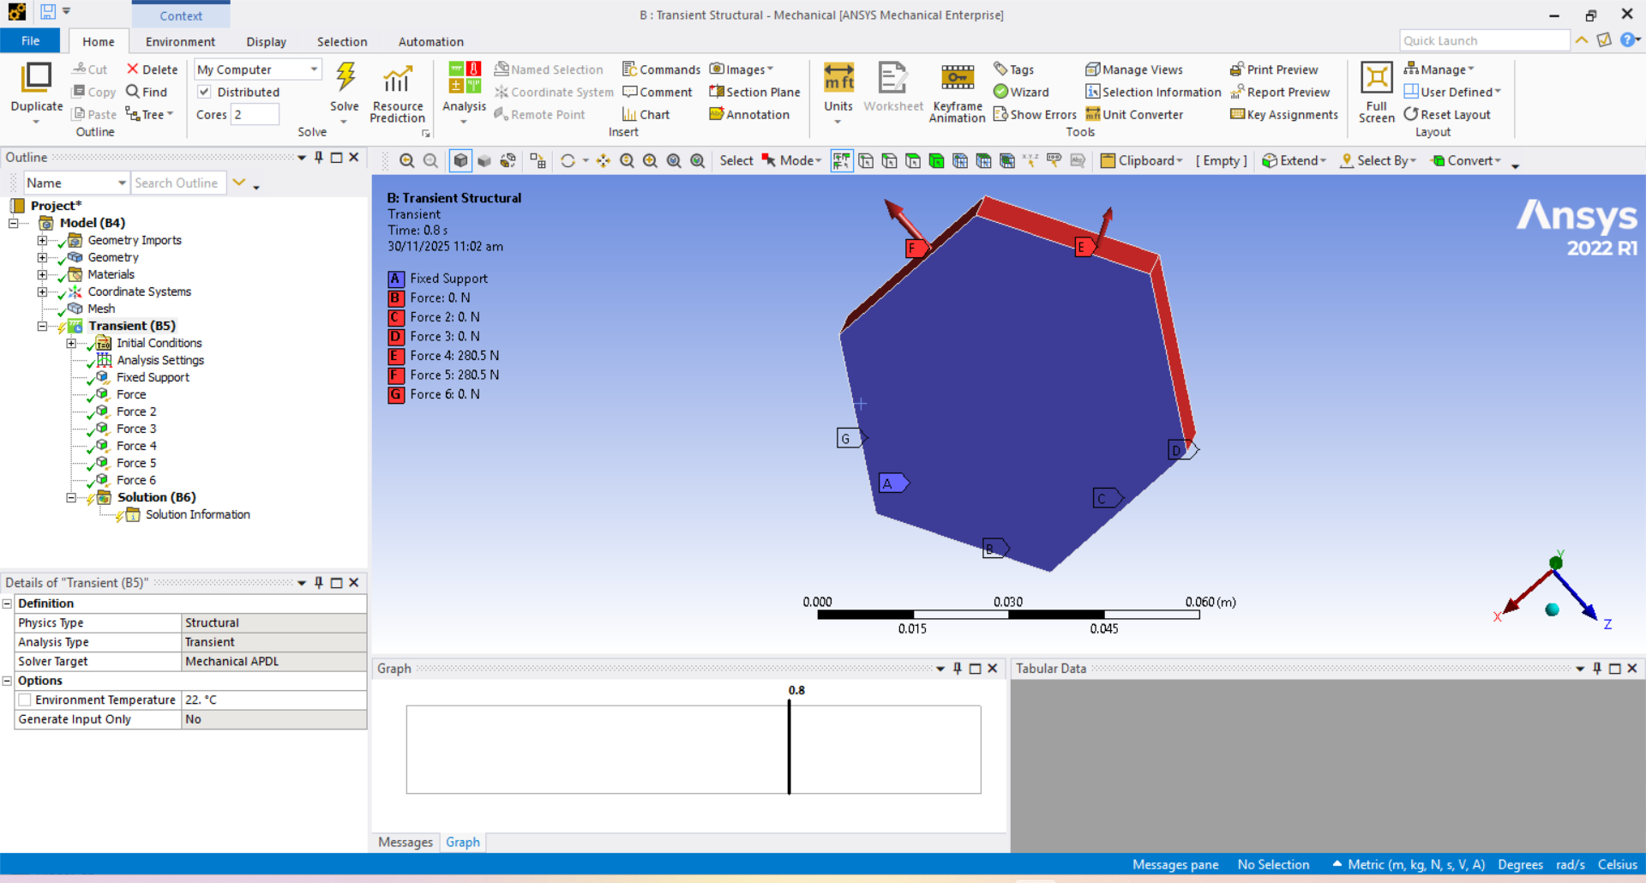
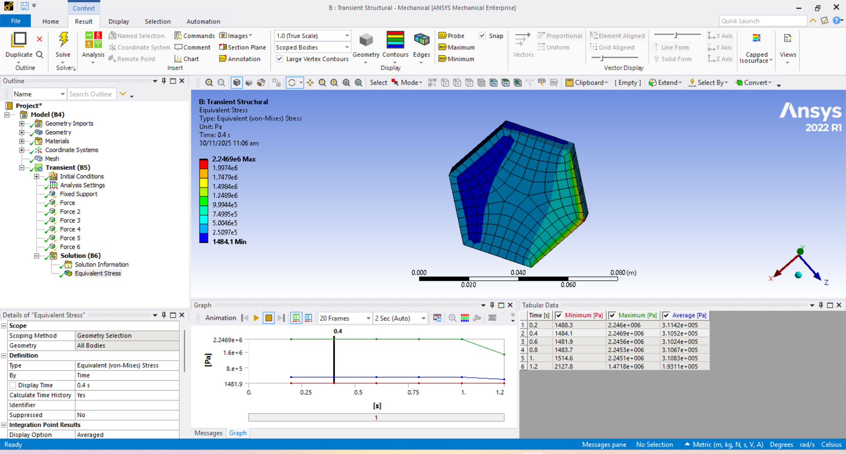
Transient Results & Conclusion
Boundary Conditions (Transient)
Results & Conclusion
Figure 10: Fixed Support (face A) and Remote Force (B,C,D,E,F,G) applied.
Figure 11: Total Deformation at t=0.4s = Total Deformation at 1.2s.

Slide 11
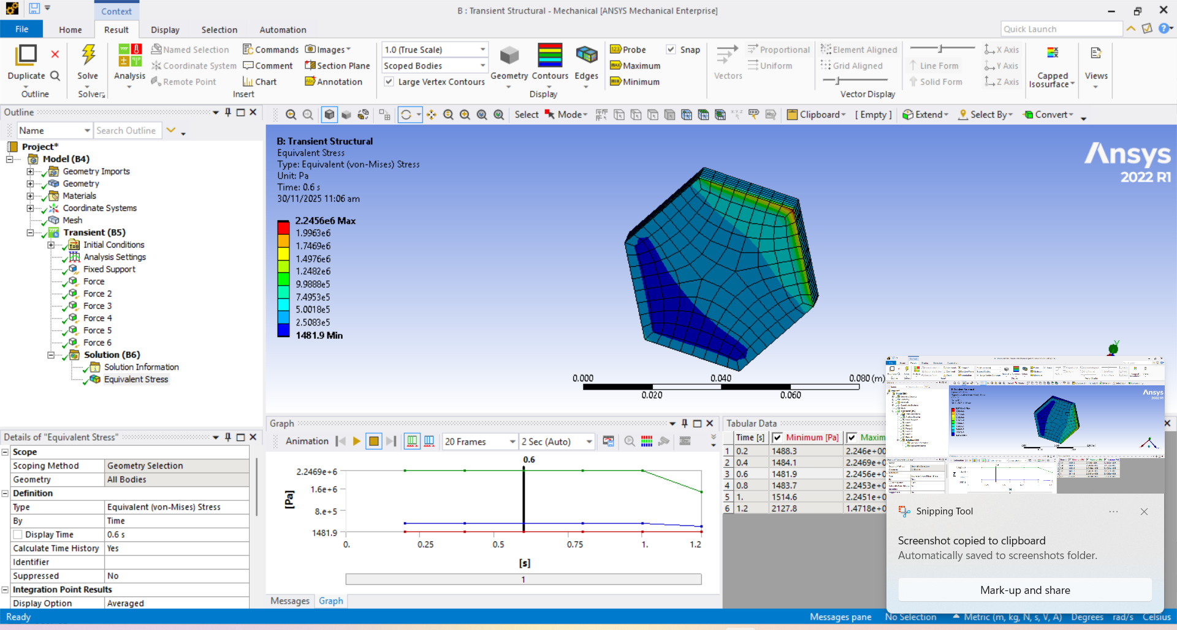
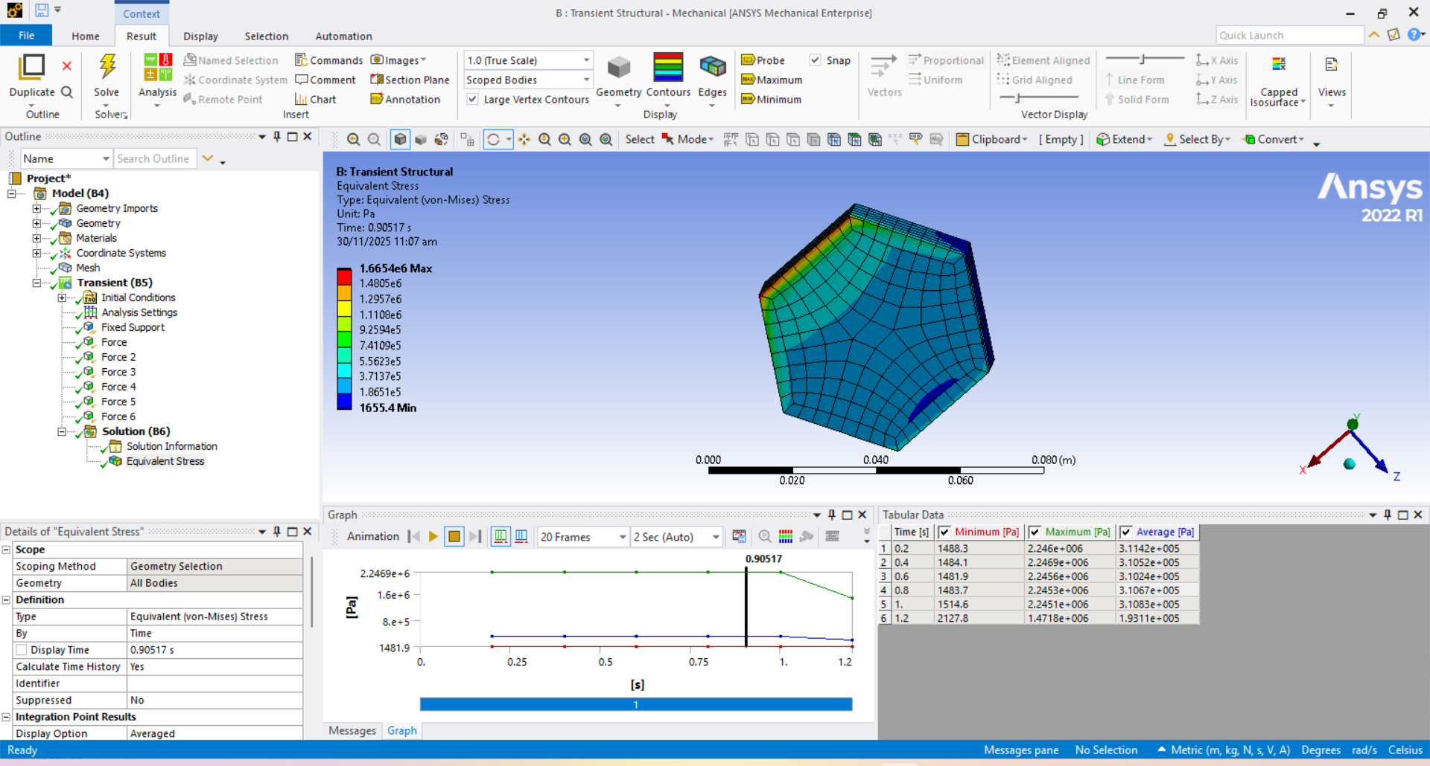
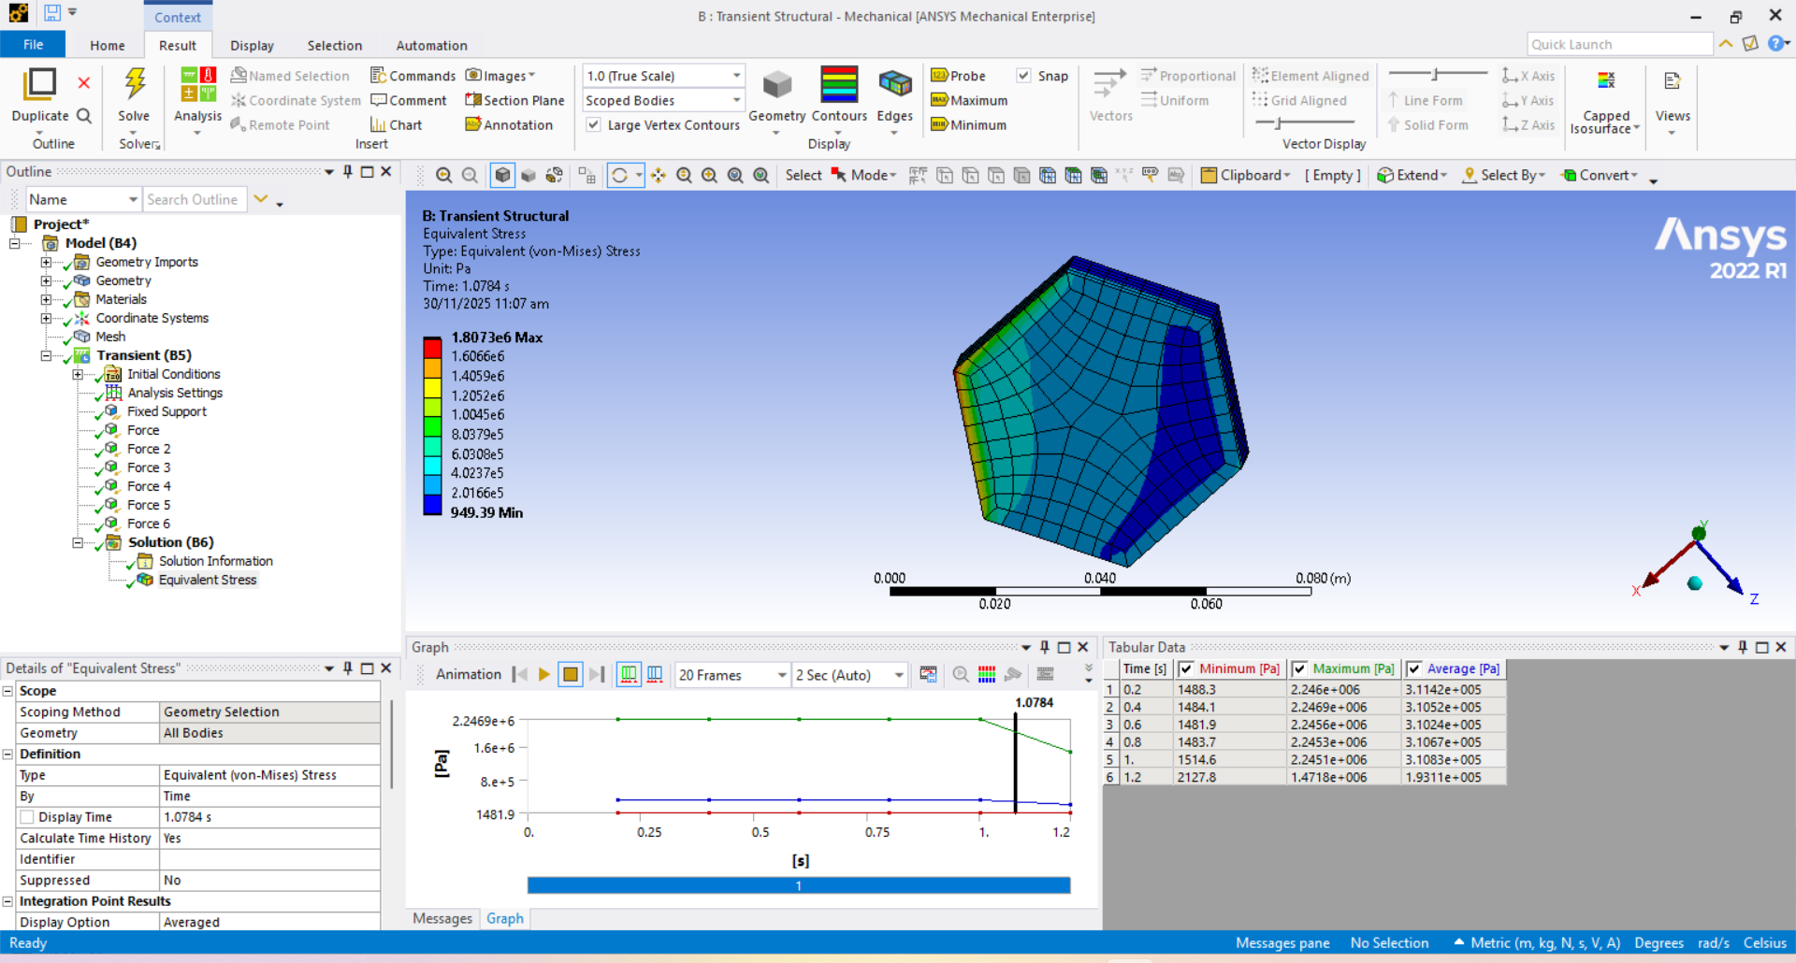
Transient Results & Conclusion
t=0.4 sec
t=0.6 sec
t=0.90517 sec
Figure 12: Equivalent Stress at different values of t (Transient).
The project successfully demonstrated FEA on a hexagon model using personal data for boundary conditions, comparing static and transient behaviors.
t=1.0784 sec

